Slide 1
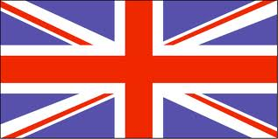
Solving Disputes with Great Britain
By- Dominic de León

Slide 2
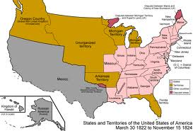
Solving Disputes with Great Britain
1. Rushbagot Agreement
A. Limited naval powers on the Great Lakes
1. Included the United States and British Canada
B. Compromised in 1817
2. Convention of 1818
A. Gave U.S fishing rights in Newfoundland and Labrador Coasts
B. Set the border between the U.S. and Canada at 49 degrees north latitude
C. Border stretched west through the Rocky Mountains
D. Resolved fur trade in Oregon Country
3. Agreement
A. Both countries agreed to occupy the Pacific Northwest together
B. This agreement would be tested for years.

Slide 3
Essential Question
Would the United States struggle more, economically, if these agreements with Great Britain weren't made?

Slide 4
The Good, The Bad, The Interesting
The Good- The Joint Occupation made it to where the U.S nor Great Britain can get an unfair advantage and dominate the Oregon Territory
The Bad- This made the fur trade in Oregon even but Great Britain wanted to control the whole Oregon Territory
The Interesting- The Oregon Treaty of 1846 ended the agreements of the Convention of 1818, giving the northern half of Oregon to British Canada and the rest to the U.S.

