Slide 1
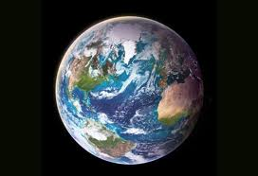
Chapter 1 Geography
The Geographer’s World

Slide 2
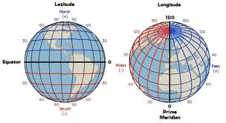
How do Geographer’s look at the world?
Five Themes of Geography
Location
Absolute Location
Latitude and Longitude
AKA site
Find the absolute location of Salem Missouri?

Slide 3
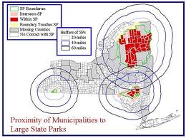
How do Geographer’s look at the world?
2. Relative Location
A position of a place in relation to another
AKA situation
What is the Relative location of Yosemite National Park?
Shopping Mall
a. What makes a good location makes a good shopping mall?(3)

Slide 4
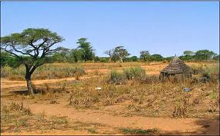
How do Geographer’s look at the world?
Place – every place is unique on earth
1. Special characteristics that makes a place unique.
2. Climate, plants, animals, land, use, culture, physical
3. Describe the following places? Use 5 characteristics.
a. Sahel –
b. Yosemite National Park -

Slide 5
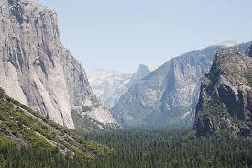
How do Geographer’s look at the world?
Human-Environment Interaction – People are constantly interacting and changing their surroundings
1. People must adapt to the environment they live in
2. Sahel – How do people adapt to the heat?
3. Yosemite National Park - How do people adapt to building and transportation in the park?
4. How have you adapted to your environment? 3 examples
5. What other negative impacts could H-E Interaction have.
1. What are two reasons the Sahel shrinking?
2. How are houses built in the Sahel?
3. How does Yosemite combat pollution?

Slide 6
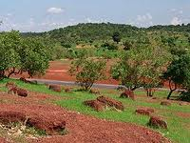
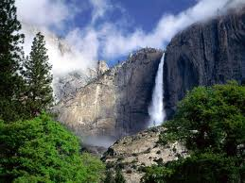
How do Geographer’s look at the world?
D. Movement – the movement of people, goods, ideas. AKA spatial interaction
1. How do people in the Sahel travel and shop?
2. How do people in Yosemite travel from place to place?
3. How do people in Salem travel and shop?

Slide 7
How do Geographer’s look at the world?
E. Region – an area defined by ONE characteristic
1. Special characteristics that makes a place unique.
2. Climate, plants, animals, land, use, culture, physical
3. What is the
a. Language region of the Sahel?
b. Religion region of the Sahel?
c. Landform region of the Sahel?
c. Name three regions in which you live?

Slide 8
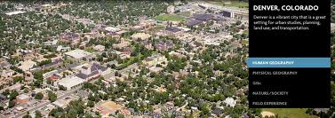
The Wild World of Geography
2 Branches of Geography
1. Human Geography
a. How people and their activities vary from place to place.
b. Political, economic, cultural
c. Cities, countries, farm or factory
d. What are three jobs that human geographers work?

Slide 9
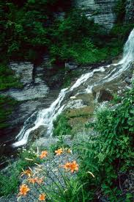
The Wild World of Geography
2. Physical Geography
a. How earth’s natural features vary from place to place.
b. Plains, mountains, water, plants, climates
c. Study the interaction of people’s with water, soil, or minerals
d. What are three jobs that physical geographers work?

Slide 10
Quiz About The Five Themes of Geography
Click the bell to the left of the correct answer.
Applause will sound if the answer is correct.
A gong will sound if the answer is incorrect.
A key to the quiz follows the last slide.
You may continue answering each question until the correct answer is found.
Click on the orange arrow key to progress through the quiz.

Slide 11
Question 1 Which of the following is NOT a geography theme?
A. movement
C. region
B. human-environmental interaction
D. people

Slide 12
Question 2 Which of the following is an example of Human-Environmental Interaction?
A. getting the mail
C. playing Gameboy
B. watching TV
D. Rainforest Clearing

Slide 13
Question 3 Which of the following helped create the 5 Themes of Geography?
A. Geographica Institute
C. Mr. Stratton created everything
B. National Geographic Society
D. Social Studies Teachers of America

Slide 14
Question 4 Which of the following is an example of PLACE?
A. Deep South
C. Dodge County Middle School
B. Camels
D. A landfill

Slide 15
Question 5 Which of the following is NOT an example of Location?
A. Springfield, Missouri
C. 35* N – 117* W
B. Dodge County Middle School
1103 Herman Ave
Eastman, GA 31023
D. the hills

Slide 16
Question 6 Which of the following is an example of region?
A. Shopping Mall
C. United States
B. South America
D. The Midwest

Slide 17
Question 7 What is the name of a person who studies the earth and everything on it?
A. Photographer
C. Geographer
B. Cartographer
D. Mapographer

Slide 18
Question 8 T or F. The Sahel has recently gone to electric vehicles to reduce pollution.
True
False

Slide 19
Question 9 Which of the following occupations is an example of Human Geography?
A. cartographer B. Meteorologists
C. Seismologists D. Urban Planner

Slide 20
Question 10 Which of the following is a positive contribution in the interaction between people and their environment?
A. A new road B. A landfill
C. irrigation D. build a new house

